Slide 1
Air Quality Index Analysis by Country
Presented by Group 10: Ewansiha Simmons, Kendall Young & Phil Faulkner

Slide 2
Motivation & Summary

Slide 3
Data Sets Used for Analysis
Most Polluted Cities and Countries (IQAir Index)
https://www.kaggle.com/datasets/ramjasmaurya/most-polluted-cities-and-countries-iqair-index?datasetId=2029905
Covid-19 Air Pollution Data
https://www.kaggle.com/datasets/ramjasmaurya/most-polluted-cities-and-countries-iqair-index?datasetId=2029905
Life Expectancy at birth 2019
https://ourworldindata.org/grapher/life-expectancy-at-birth-total-years?tab=table

Slide 4
Reason we chose this dataset.
Air Quality is an Overlooked Standard to Assess Health in an Area.
The Dataset has complete Pre and Post COVID Data.
The Dataset had a Variety of Countries from all over the World.
Life Expectancy Dataset had all of the Countries in the Air Quality Dataset.
Time Period for Air Quality Index is 2018-2021.

Slide 5
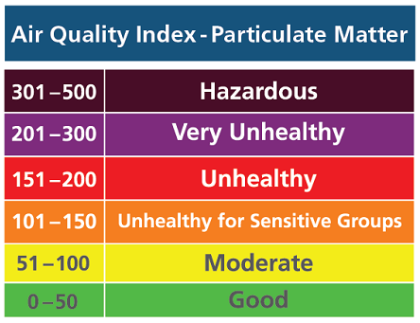
Air Quality Index Scale

Slide 6
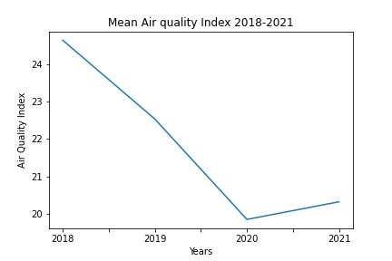
What is the largest movement/transition in air quality index per country (pre-covid vs post covid)?
2018 AQI Mean 24.634722
2019 AQI Mean 22.530556
2020 AQI Mean 19.848611
2021 AQI Mean 20.319444

Slide 7
Phil 2nd Slide

Slide 8
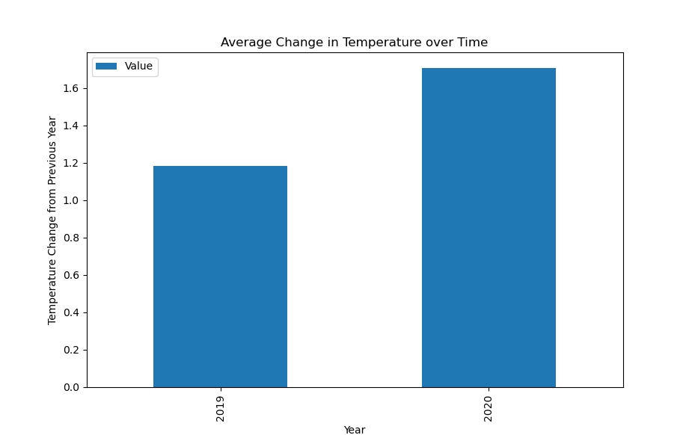
Does the Air Quality Index affect the average temperature change(value) over time?
+1.18
+1.71

Slide 9
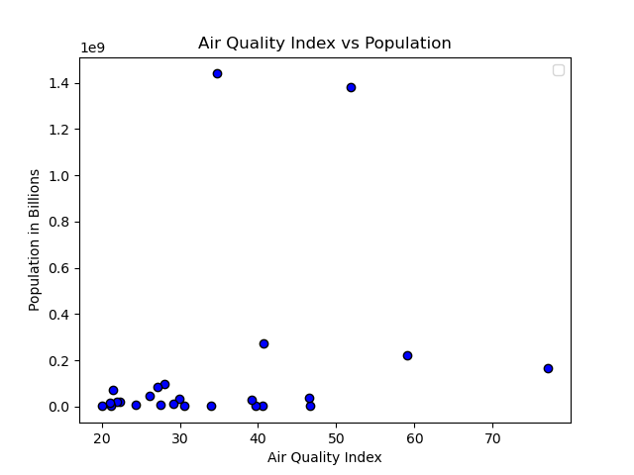
Is there a relationship between population and AQI on average?
25 Country Sampling
Smaller population has better AQI per sample

Slide 10
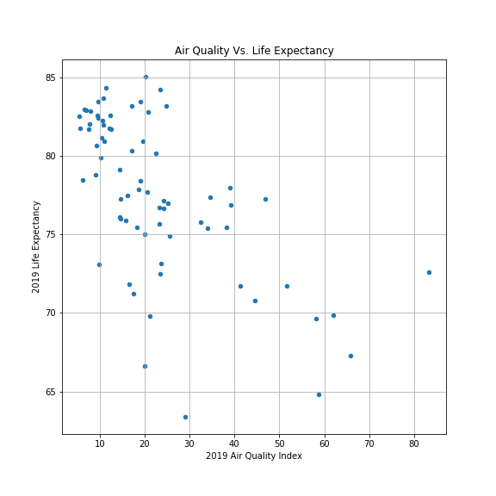
Is there a correlation between life expectancy and air quality for the countries in the dataset?
72 Country Sampling
Negative Correlation between high AQI and Life Expectancy

Slide 11
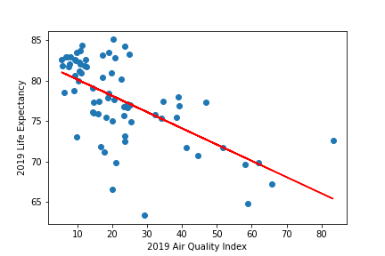
Is there a correlation between life expectancy and air quality for the countries in the dataset?
Y = -0.2X +82.14
72 Country Sampling
Negative Correlation between high AQI and Life Expectancy

Slide 12
Future Considerations

